Slide 1
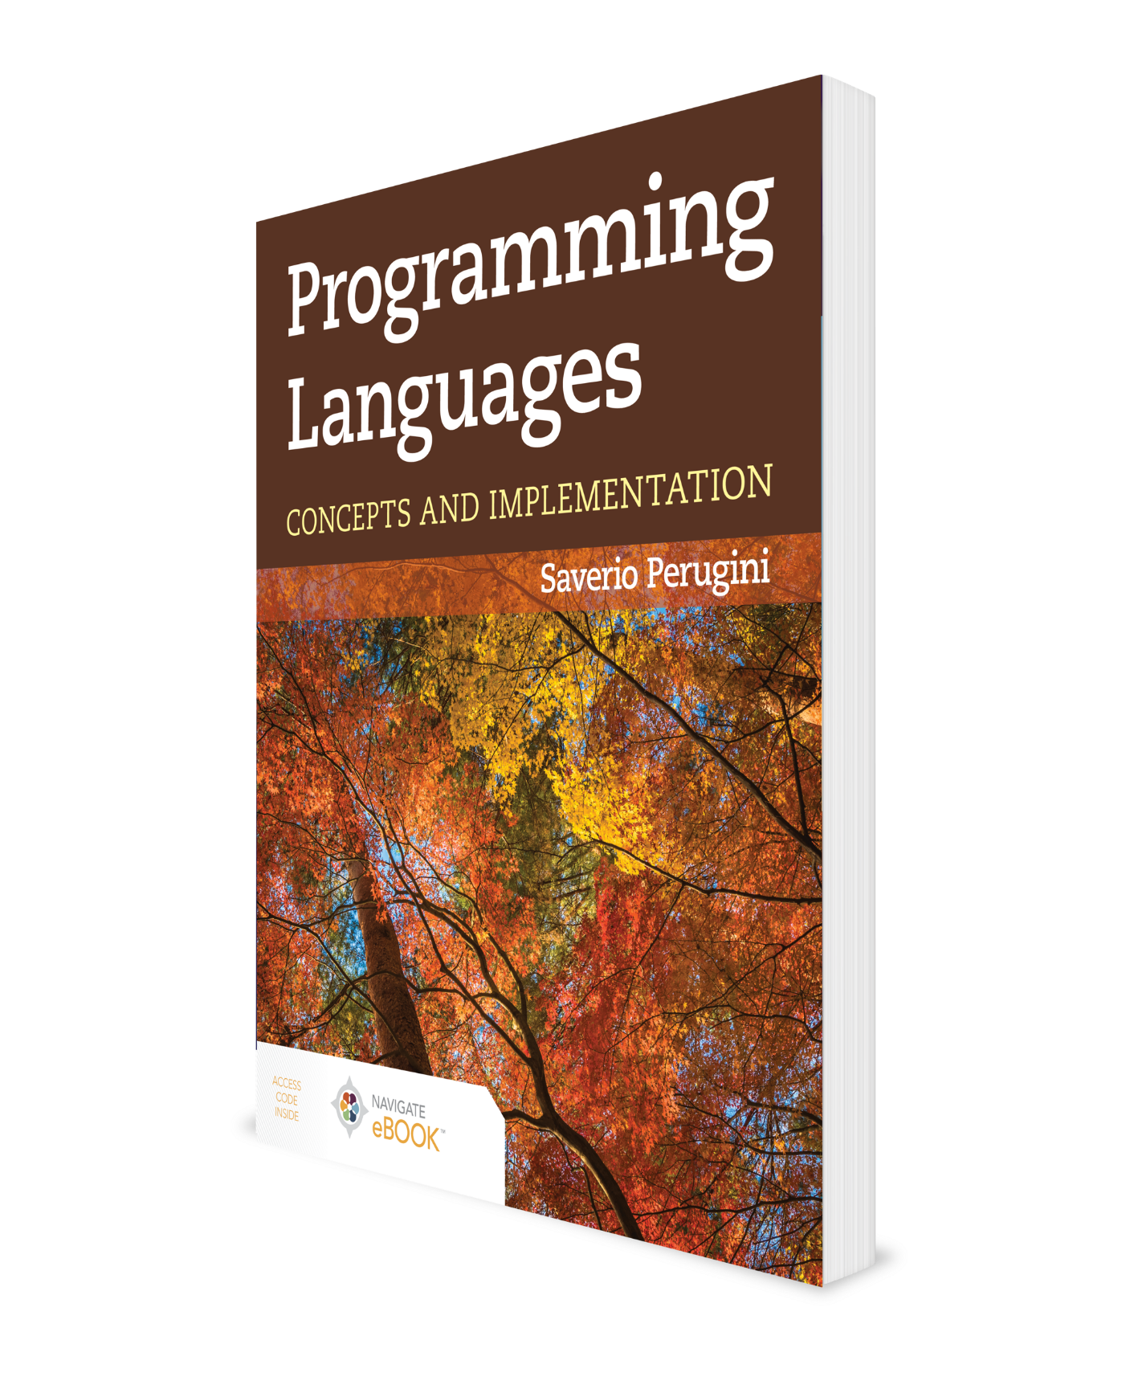
Currying and Higher-Order Functions
CHAPTER 8

Slide 2
Chapter 8: Currying and Higher-Order Functions
[T]here are two ways of constructing a software design: One way is to make it so simple that there are obviously no deficiencies and the other way is to make it so complicated that there are no obvious deficiencies. The first method is far more difficult.
—Tony Hoare, 1980 ACM A. M. Turing Award Lecture
The concept of static typing leads to type inference and type signatures for functions (all of which are covered in Chapter 7), which lead to the concepts of currying and partial function application, which we discuss in this chapter. All of these concepts are integrated in the context of higher-order functions, which also provide us with tools and techniques for constructing well-designed and -factored software systems, including interpreters (which we build in Chapters 10–12).

Slide 3
Outline
8.1 Chapter Objectives
8.2 Partial Function Application
8.3 Currying
8.4 Putting It All Together: Higher-Order Functions
8.5 Analysis
8.6 Thematic Takeaways

Slide 4
1.2 Chapter Objectives
Explore the programming language concepts of partial function application and currying.
Describe higher-order functions and their relationships to curried functions, which together support the development of well-designed, concise, elegant, and reusable software.

Slide 5
Outline
8.1 Chapter Objectives
8.2 Partial Function Application
8.3 Currying
8.4 Putting It All Together: Higher-Order Functions
8.5 Analysis
8.6 Thematic Takeaways

Slide 6
8.2 Partial Function Application (1 of 3)
With partial function application, for any function f (p₁, p₂, ..., p_{n}),
such that

Slide 7
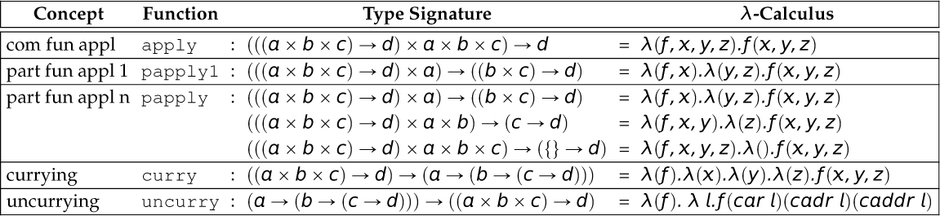
Table 8.1 Type Signatures and λ-Calculus for a Variety of Higher-Order Functions
Each signature assumes a ternary function ƒ : (a ⨉ b ⨉ c) ➝ d. All of these functions except apply return a function. In other words, all but apply are closed operators.

Slide 8
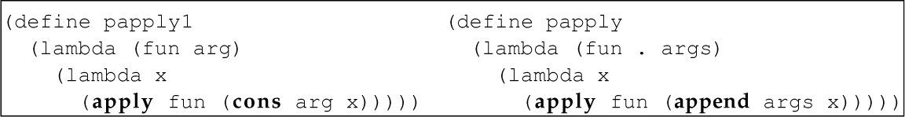
Table 8.2 Definitions of papply1 and papply in Scheme

Slide 9
8.2 Partial Function Application (2 of 3)
More generally, with partial function application, for any function f (p₁, p₂, ..., p_{n}),
where m ⩽ n, such that

Slide 10
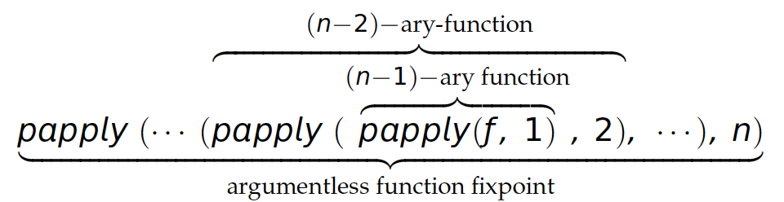
8.2 Partial Function Application (3 of 3)
More formally, assuming an n-ary function ƒ, where n > 0:

Slide 11
Outline
8.1 Chapter Objectives
8.2 Partial Function Application
8.3 Currying
8.4 Putting It All Together: Higher-Order Functions
8.5 Analysis
8.6 Thematic Takeaways

Slide 12
8.3 Currying
Currying refers to converting an n-ary function into one that accepts only one argument and returns a function, which also accepts only one argument and returns a function that accepts only one argument, and so on.
For now, we can think of a curried function as one that permits transparent partial function application (i.e., without calling papply1 or papply).
In other words, a curried function (or a function written in curried form, as discussed next) can be partially applied without calling papply1 or papply.
Later, we see that a curried function is not being partially applied at all.

Slide 13
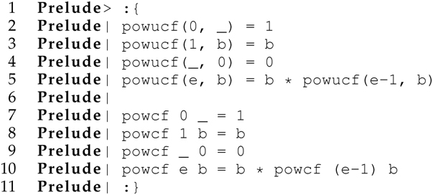
8.3.1 Curried Form in Haskell (1 of 4)
Consider the following two definitions of a power function (i.e., a function that computes a base b raised to an exponent e, b^{e}) in Haskell:
The definition of the powucf function has a comma between each parameter in the tuple of parameters, and that tuple is enclosed in parentheses
There are no commas and parentheses in the parameters tuple in the definition of the powcf function.
These two definitions are almost the same.
But the types of these functions are different.

Slide 14
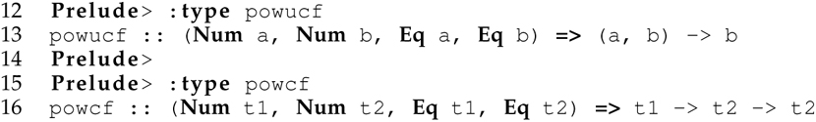
8.3.1 Curried Form in Haskell (2 of 4)
The type of the powucf function states that it accepts a tuple of values of a type in the Num class and returns a value of a type in the Num class.
In contrast, the type of the powcf function indicates that it accepts a value of a type in the Num class and returns a function mapping a value of a type in the Num class to a value of the same type in the Num class.

Slide 15
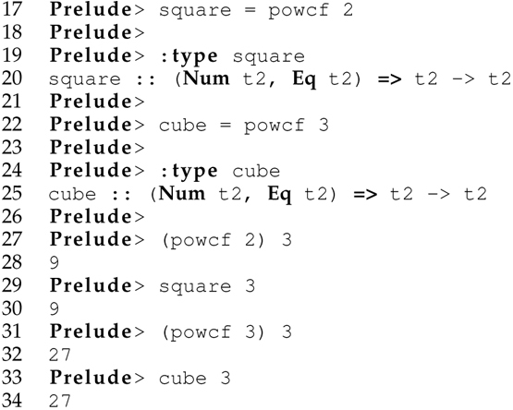
8.3.1 Curried Form in Haskell (3 of 4)
The definition of powcf is written in curried form, meaning that it accepts only one argument and returns a function, also with only one argument:

Slide 16
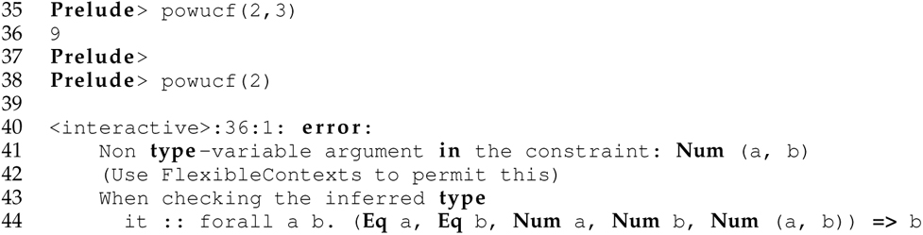
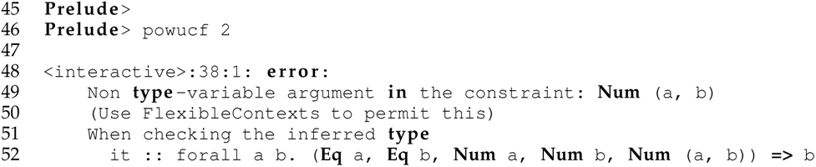
8.3.1 Curried Form in Haskell (4 of 4)
By contrast, the definition of powucf is written in uncurried form, meaning that it must be invoked with arguments for all of its parameters with parentheses around the argument list and commas between individual arguments.
powucf cannot be partially applied, without the use of papply1 or papply
It must be completely applied:

Slide 17
8.3.2 Currying and Uncurrying (1 of 2)
In general, currying transforms a function ƒ_{uncurried} with the type signature
into a function ƒ_{curried} with the type signature
such that

Slide 18
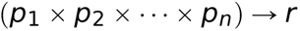
8.3.2 Currying and Uncurrying (2 of 2)
Currying ƒ_{uncurried} and running the resulting ƒ_{curried} function has the same effect as progressively partially applying ƒ_{uncurried}.
Inversely, uncurrying transforms a function ƒ_{curried} with the type signature
into a function ƒ_{uncurried} with the type signature
such that

Slide 19
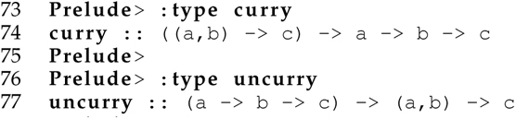
8.3.3 The curry and uncurry Functions in Haskell
The built-in Haskell functions curry and uncurry are used to convert a binary function between uncurried and curried forms:

Slide 20
Table 8.3 Definitions of curry and uncurry in Curried Form in Haskell for Binary Functions
Notice that the definitions of curry and uncurry in Haskell are written in curried form.

Slide 21
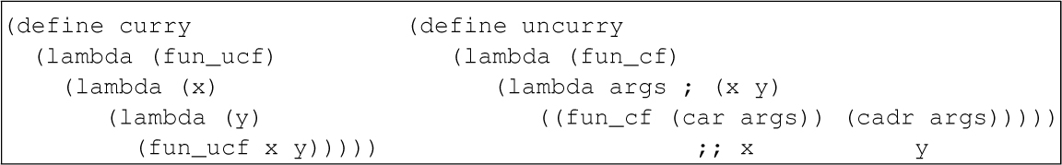
Table 8.4 Definitions of curry and uncurry in Scheme for Binary Functions

Slide 22
8.3.4 Flexibility in Curried Functions
A curried function is more flexible than its uncurried analog because it can effectively be invoked in n ways, where n is the number of arguments its uncurried analog accepts:
The one and only way its uncurried analog is invoked (i.e., with all arguments as a complete application)
The one and only way it itself can be invoked (i.e., with only one argument)
n - 2 other ways corresponding to implicit partial applications of each returned function
Any curried function can effectively be invoked with arguments for any prefix, akin to partial function application, including all of the parameters of its uncurried analog, without parentheses around the list of arguments or commas between individual arguments.

Slide 23
8.3.5 All Built-in Functions in Haskell Are Curried (1 of 2)
This is why Haskell is referred to as a fully curried language.
This is not the case in ML.
Consider our final definition of mergesort in Haskell given in online Appendix C.
Neither the mergesort function nor the compop function is curried.
Thus, we cannot pass in the built-in < or > operators, because they are curried.

Slide 24
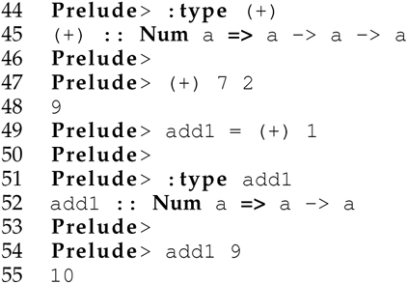
Converting an Infix Operator to a Prefix Operator
When passing an operator as an argument to a function, the passed operator must be a prefix operator.
Since the operators < and > are infix operators, we cannot pass them to this version of mergesort without first converting them to prefix operators.
We can convert an infix operator to a prefix operator in Haskell either by wrapping it in a user-defined function or by enclosing it within parentheses:

Slide 25
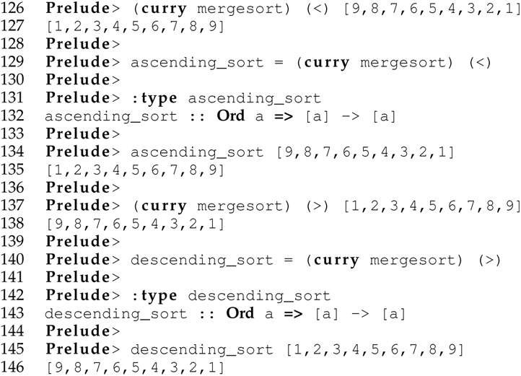
8.3.5 All Built-in Functions in Haskell Are Curried (2 of 2)
The function mergesort is an ideal candidate for currying because by applying it in curried form with the < or > operators, we get back ascending-sort and descending-sort functions, respectively:

Slide 26
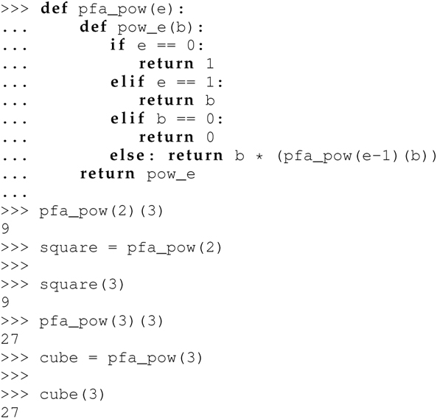
8.3.6 Supporting Curried Form Through First-Class Closures
Any language with first-class closures can be used to define functions in curried form.
For instance, because Python supports first-class closures, we can define the pow function in curried form in Python:
Here the curried form is too tightly woven into the function definition (like Scheme, but unlike ML/Haskell).
Moreover, pfa_pow cannot be completely applied (again, like Scheme, but unlike ML/Haskell).

Slide 27
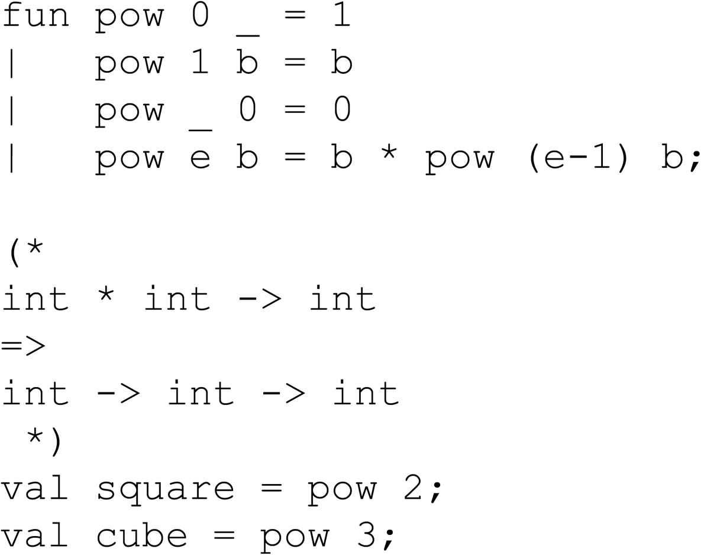
8.3.7 ML Analogs (Curried Form in ML)
Same as in Haskell
Not all built-in ML functions are curried as in Haskell.
e.g., map is curried, while Int.+ is uncurried.
Also, there are no built-in curry and uncurry functions in ML.

Slide 28
8.4 Putting It All Together: Higher-Order Functions
Curried functions open up new possibilities in programming, especially with respect to higher-order functions (HOFs).
A HOF, such as map in Scheme, is a function that either accepts functions as arguments or returns a function as a value, or both.
Such functions capture common, typically recursive, programming patterns as functions.
They provide the glue that enables us to combine simple functions to make more complex functions.
Most HOFs are curried, which makes them powerful and flexible.
Writing a program to solve a problem with HOFs requires:
Creative insight to discern the applicability of a HOF approach to solving a problem
The ability to decompose the problem and develop atomic functions at an appropriate level of granularity to foster:
A solution to the problem at hand by composing atomic functions with HOFs
The possibility of recomposing the constituent functions with HOFs to solve alternative problems in a similar manner

Slide 29
8.4.1 Functional Mapping
The map function in ML and Haskell accepts only a unary function and returns a function that accepts a list and applies the unary function to each element of the list, and returns a list of the results.
The HOF map is also built into both ML and Haskell and is curried in both.

Slide 30
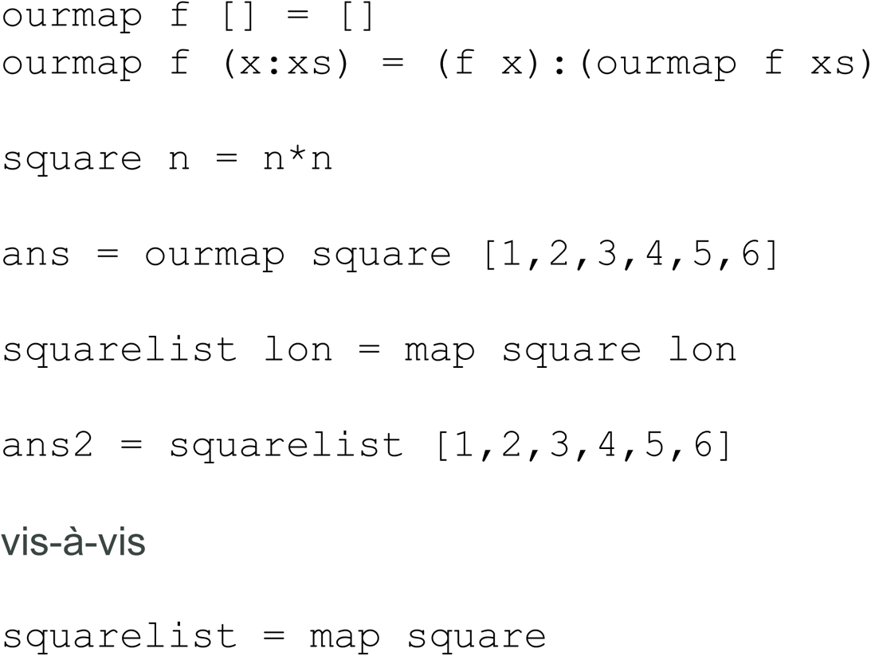
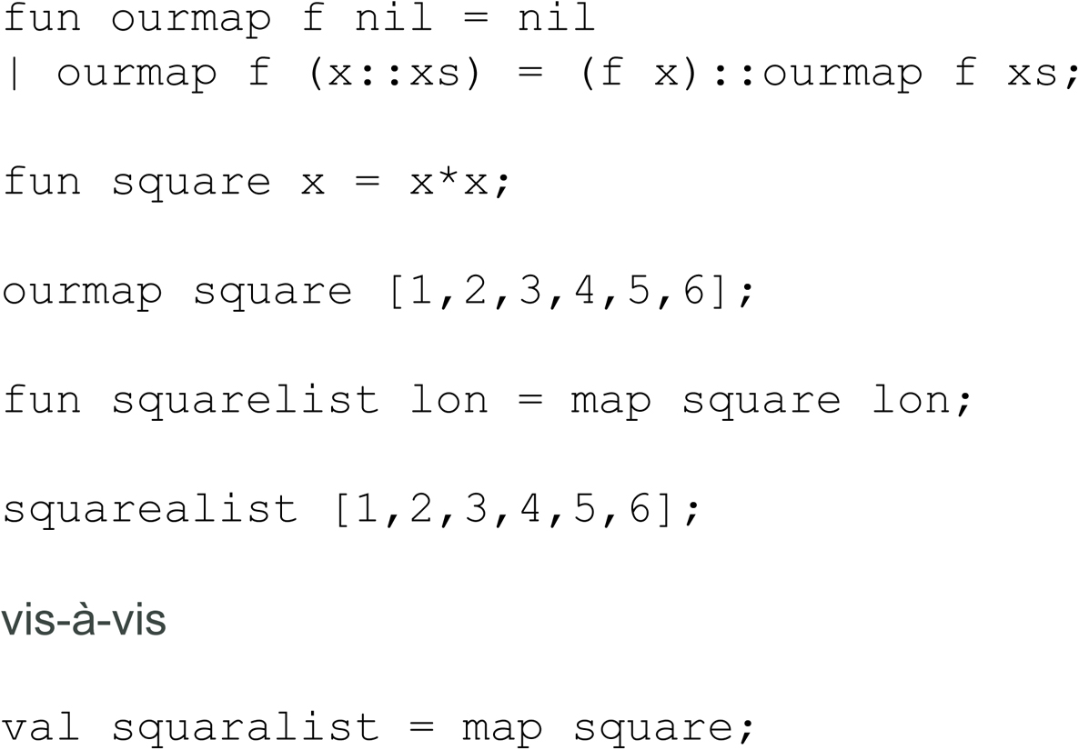
Mapping in Haskell (left) Vis-à-Vis ML (right)
Haskell
ML

Slide 31
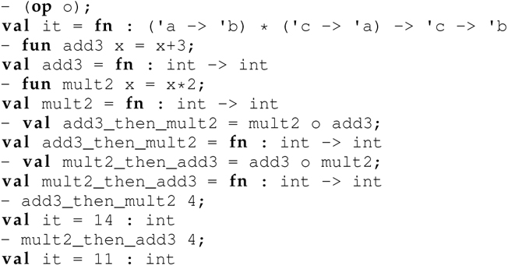
8.4.2 Functional Composition
The function composition operator that accepts only two unary functions and returns a function that invokes the two in succession.
In mathematics, g ○ ƒ = g(ƒ(x)), which means
“first apply ƒ and then apply g” or
“g followed by ƒ” or “g of ƒ of x.”
The functional composition operator is . in Haskell and o in ML:

Slide 32
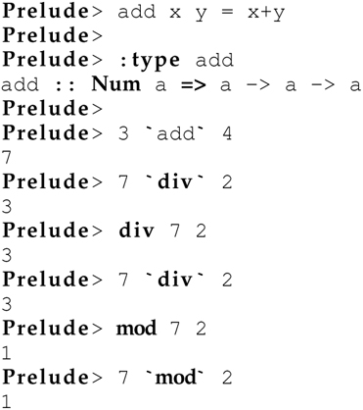
8.4.3 Sections in Haskell (1 of 4)
In Haskell, any binary function or binary prefix operator (e.g., div and mod) can be converted into an equivalent infix operator by enclosing the name of the function in grave quotes (e.g., ‘div‘):

Slide 33
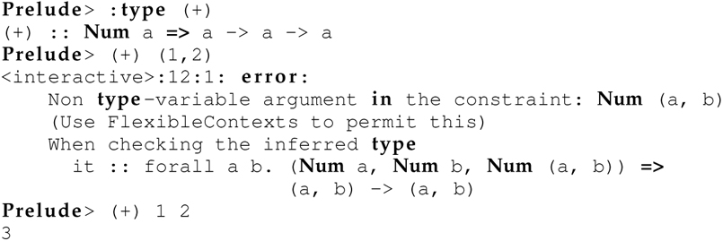
8.4.3 Sections in Haskell (2 of 4)
Parenthesizing an infix operator in Haskell converts it to the equivalent curried prefix operator:

Slide 34
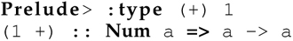
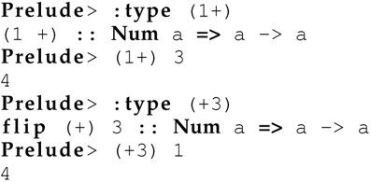
8.4.3 Sections in Haskell (3 of 4)
An operator in Haskell can be partially applied only if it is both curried and invocable in prefix form:
This convention also permits one of the arguments to be included in the parentheses
Which both converts the infix binary operator to a prefix binary operator and partially applies it in one stroke:

Slide 35
Uses of Sections
Constructing simple and succinct functions. Example: (+3)
Declaring the type of an operator (because an operator itself is not a valid expression in Haskell). Example:
Passing a function to a higher-order function. Example: map (+1)[1,2,3,4]

Slide 36
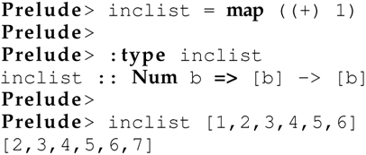
8.4.3 Sections in Haskell (4 of 4)
The same is not possible in ML because built-in operators (e.g., + and *) are not curried in ML.
To convert an infix operator (e.g., + and *) to the equivalent prefix operator in ML, we must enclose the operator in parentheses (as in Haskell) and also include the lexeme op after the opening parenthesis:
The concepts of mapping, functional composition, and sections are interrelated:

Slide 37
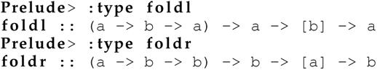
8.4.4 Folding Lists
The built-in ML and Haskell functions foldl (“fold left”) and foldr (“fold right”), like map, capture a common pattern of recursion.
These list folding functions are helpful for defining a variety of functions.
The functions foldl and foldr both accept only
a prefix binary function (sometimes called the folding function or the combining function),
a base value (i.e., the base of the recursion), and
a list, in that order:

Slide 38
foldr in Haskell
The function foldr folds a function, given an initial value, across a list from right to left:
where ⊕ is a symbol representing an operator.

Slide 39
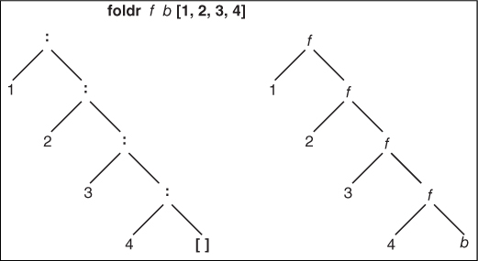
Figure 8.1 foldr Using the Right-associative : cons Operator

Slide 40
foldl in Haskell
The function foldl folds a function, given an initial value, across a list from left to right:
where ⊕ is a symbol representing an operator. Notice that the initial value v appears on the left-hand side of the operator with foldl and on the right-hand side with foldr.

Slide 41
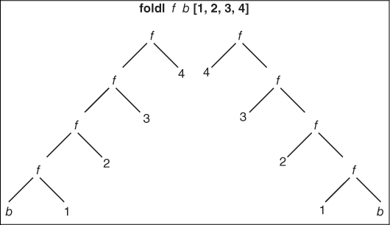
Figure 8.2 foldl in Haskell (left) Vis-à-Vis foldl in ML (right)

Slide 42
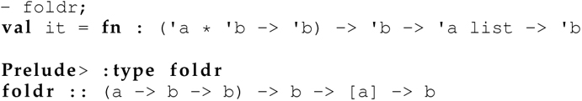
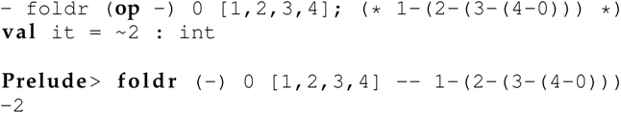
foldr in ML
The types of foldr in ML and Haskell are the same.
foldr has the same semantics in ML and Haskell.

Slide 43

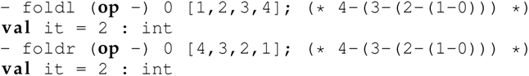
foldl in ML
The types of foldl in ML and Haskell differ:
foldl has different semantics in ML and Haskell.
In ML, the function foldl is computed as follows:
Unlike in Haskell, foldl in ML is the same as foldr in ML (or Haskell) with a reversed list:

Slide 44
8.4.5 Crafting Cleverly Conceived Functions with Curried HOFs
Curried HOFs are powerful programming abstractions that support the definition of functions succinctly.
We demonstrate the construction of the following three functions using curried HOFs:
implode: a list-to-string conversion function (online Appendix B)
string2int: a function that converts a string representing a non-negative integer to the corresponding integer
powerset: a function that computes the powerset of a set represented as a list

Slide 45
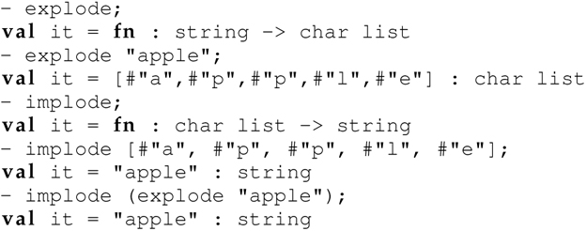
implode (1 of 3)
Consider the following explode and implode functions from online Appendix B:

Slide 46
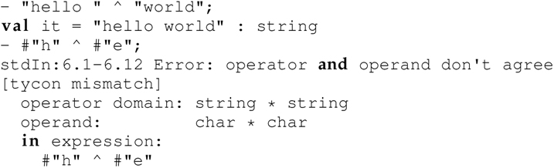
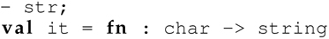
implode (2 of 3)
We can define implode using HOFs:
However, the string concatenation operation ˆ only concatenates strings, and not characters:
We need a helper function that converts a value of type char to value of type string:

Slide 47
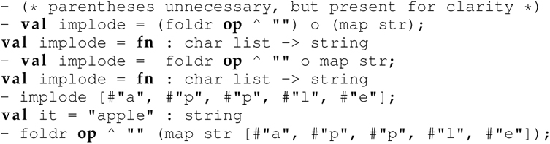
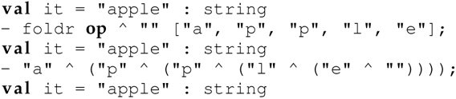
implode (3 of 3)
Now we can use the HOFs foldr, map, and o (i.e., functional composition) to compose the atomic elements:
Notice: The functions map and foldr (and foldl) are defined in curried form in ML.

Slide 48
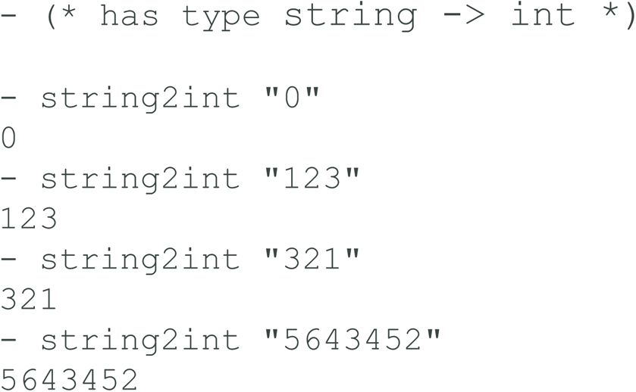
string2int (1 of 4)
Let’s implement a function that converts a string representing a nonnegative integer into the equivalent integer.
We can use explode to decompose a string into a list of chars.
We must recognize that, for example, 123 = (3 + 0) + (2 * 10) + (1 * 100).
We start by defining a function that converts a char to an int:

Slide 49
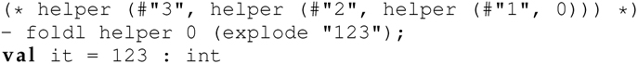
string2int (2 of 4)
Now we can define another helper function that invokes char2int and acts as an accumulator for the integer being computed:
We are now ready to glue the elements together with foldl:

Slide 50
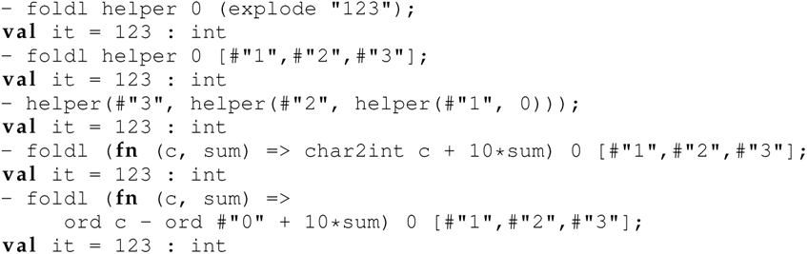
string2int (3 of 4)
Since we use foldl in ML, we can think of the characters of the reversed string as being processed from right to left.
The function helper converts the current character to an int and then adds that value to the product of 10 times the running sum of the integer representation of the characters to the right of the current character:

Slide 51
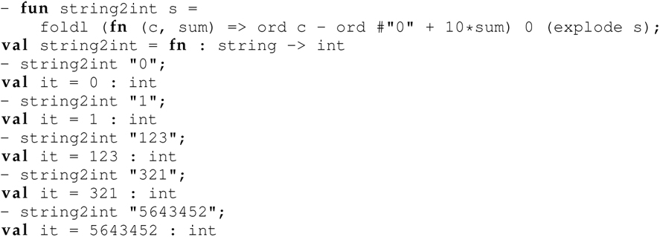
string2int (4 of 4)
Thus, we have:
After inlining an anonymous function for helper, the final version of the function is:

Slide 52
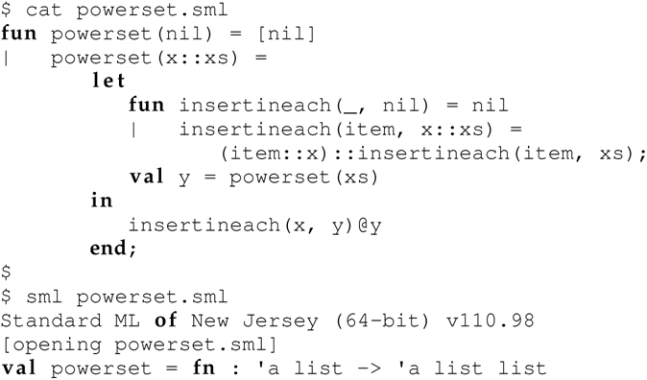
powerset (1 of 2)
The following code from online Appendix B is the definition of a powerset function:

Slide 53
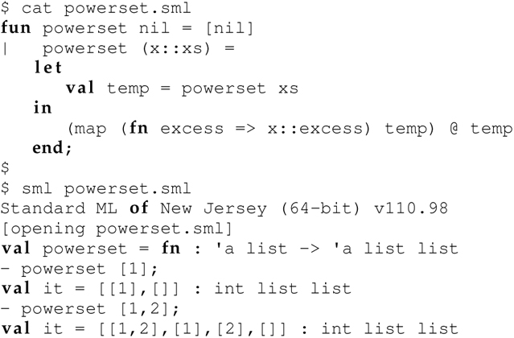
powerset (2 of 2)
Using the HOF map, we can make this definition more succinct:
Use of the built-in HOF map in this revised definition obviates the need for the nested helper function insertineach.

Slide 54
Summary
Higher-order functions support the capture and reuse of a pattern of recursion or, more generally, a pattern of control.
Curried HOFs provide the glue that enables programmers to compose reusable atomic functions together in creative ways.
The resulting functions can be used in concert to craft a malleable/reconfigurable program.
What results is a general set of (reusable) tools resembling an API rather than a monolithic program.
This style of modular programming makes programs easier to debug, maintain, and reuse (Hughes 1989).

Slide 55
Outline
8.1 Chapter Objectives
8.2 Partial Function Application
8.3 Currying
8.4 Putting It All Together: Higher-Order Functions
8.5 Analysis
8.6 Thematic Takeaways

Slide 56
8.5 Analysis (1 of 3)
Higher-order functions capture common, typically recursive, programming patterns as functions.
When HOFs are curried, they can be used to automatically define atomic functions—rendering the HOFs more powerful.
Curried HOFs help programmers define functions in a modular, succinct, and easily modifiable/reconfigurable fashion.
In this style of programming, programs are composed of a series of concise function definitions that are defined through the application of (curried) HOFs
map;
functional composition: o in ML and . in Haskell; and
foldl/foldr.

Slide 57
8.5 Analysis (2 of 3)
Programming becomes essentially the process of creating composable building blocks and combining them like LEGO(R) bricks in creative ways to solve a problem.
The resulting programs are more concise, modular, and easily reconfigurable than programs where each individual function is defined literally (i.e., hardcoded).
The challenge and creativity require determining the appropriate level of granularity of the atomic functions, figuring out how to automatically define them using (built-in) HOFs, and then combining them using other HOFs into a program so that they work in concert
Resembles building a library or API more than an application program.
Focus is more on identifying, developing, and using the appropriate higher-order abstractions than on solving the target problem.

Slide 58
8.5 Analysis (3 of 3)
Once the abstractions and essential elements have crystallized, solving the problem at hand is an afterthought.
The pay-off, of course, is that the resulting abstractions can be reused in different arrangements in new programs to solve future problems.

Slide 59
Outline
8.1 Chapter Objectives
8.2 Partial Function Application
8.3 Currying
8.4 Putting It All Together: Higher-Order Functions
8.5 Analysis
8.6 Thematic Takeaways

Slide 60
8.6 Thematic Takeaways
First-class, lexical closures are an important primitive construct for creating programming abstractions (e.g., partial function application and currying).
Higher-order functions capture common, typically recursive, programming patterns as functions.
Currying a higher-order function enhances its power because such a function can be used to automatically define new functions.
Curried, higher-order functions also provide the glue that enables you to combine these atomic functions to construct more complex functions.
HOFs + Currying Concise Functions + Reconfigurable Programs
HOFs + Currying (Curried HOFs) ⟿ Modular Programming

